Slide 1


Live ASL Interpretation: Bridging the Communication Gap
Organized By
Vishnu Waman Thakur Charitable Trust’s
VIVA Institute of Technology
Shirgaon, Virar(E), Taluka-Vasai, District-Palghar, Maharashtra

Slide 2
Live ASL Interpretation: Bridging the Communication Gap
Prof .Hima kantharia
Rani Rajpurohit
Sejal Nar
Diksha Patil

Slide 3
ABSTRACT
Live American Sign Language (ASL) interpretation plays a pivotal role in enhancing communication accessibility for Deaf and Hard of Hearing individuals.
This presentation explores the process and significance of live ASL interpretation in real-time settings, such as educational environments, public events, and digital platforms. It will delve into the techniques employed by interpreters, the challenges they face, and cultural impact of ASL interpretation in fostering inclusivity and ensuring equal access to information the importance of accurate and effective communication.
Furthermore, the presentation will highlight the social and and participation for Deaf and Hard of Hearing communities.
By understanding of live ASL interpretation, we can better appreciate its role in creating a more inclusive society where everyone can fully engage in meaningful interactions.

Slide 4
INTRODUCTION
LIVE asl interpretation is real time translation of American Sign Language into the text ,ensuring that individuals who are deaf or hard of hearing can fully participate in conversations , events , or any public public activity.
Whether in classroom ,conference , emergency situation or even through virtual platform live asl interpreters play crucial role in making communication accessible.
In live ASL interpretation we majorly focus on the problem related to light , speed and Accuracy .
Using Frameworks like YOLO (Darknet, PyTorch, or TensorFlow), OpenCV, TensorFlow/PyTorch .

Slide 5
Problem Statement
Live ASL interpretation faces several challenges that impact its effectiveness. Balancing speed and accuracy is a key issue, as interpreters must translate spoken language in real-time without sacrificing clarity, especially in complex or fast-paced settings. Contextual understanding is crucial, as ASL varies by region and culture, and misinterpretation can occur if regional signs or cultural nuances are overlooked. Interpreter fatigue is another concern, as the mental strain of continuous interpretation can lead to errors over time. Environmental factors like poor lighting or background noise also hinder the clarity of signs, while a shortage of qualified interpreters, particularly in specialized fields, can result in delays or lower-quality service. Remote interpretation often faces technological issues such as lag or poor video quality, which can disrupt communication. Additionally, interpreters must remain impartial in sensitive situations, maintaining confidentiality while ensuring accurate communication, all of which can be physically demanding. Lastly, interpreting non-verbal cues, such as facial expressions and body language, is vital in ASL, but challenges arise when these cues are misread or lost. These problems highlight the need for improved training, technology, and resources to support interpreters and enhance accessibility.

Slide 6
Literature Survey
TITLE | USED TECHNOLOGY | ADVANTAGES | DISADVANTAGES
PAPER 1:- Sign Language to text and speech conversion | Raspberry Pi 3: For processing tasks. Neural Networks: For gesture recognition. | Cost-Effective: Utilizes affordable Raspberry Pi., Real-Time: Fast gesture-to-speech conversion. | Limited Recognition: Supports few gestures initially., Lighting Sensitivity: Performance varies with light.
PAPER 2:- Sign Language to text and speech conversion | Employs HSV model for skin detection and PCA for feature extraction. Captures gestures using an internal mobile camera. | Other models may lack speed or accuracy., Performance affected by camera position and signer proximity. | Utilizes Media Pipe, FRCNN, for gesture recognition. Employs HSV model for skin detection and PCA for feature extraction.

Slide 7
PAPER 3:-Sign Language Conversion to Text | Media Pipe for gesture recognition. Image processing techniques for feature extraction. | Real-time translation for instant communication. User-friendly with no need for special equipment. | Performance affected by environment and camera setup. Accuracy issues with complex gestures or dialects.
PAPER 4:- Image processing for gesture recognition. Open CV for visual processing. | Image processing for gesture recognition. Open CV for visual processing. | Enhances communication between deaf and hearing individuals. Promotes inclusivity and reduces isolation. | May create dependency on technology. Potential accuracy issues in gesture recognition.
PAPER 5:- Enhances communication between deaf and hearing individuals. Promotes inclusivity and reduces isolation. | Utilizes deep learning models like CNN and VGG16. Employs image segmentation for gesture recognition. | Enhances communication between the deaf and hearing communities. User-friendly app design for easy accessibility. | Requires high-end hardware for optimal performance. Complex development process. Requires high-end hardware for optimal performance. Complex development process.
PAPER 6:- Breaking the Silence: An innovative ASL to Text Conversion System Leveraging Computer Vision & Machine Learning for Enhanced Communication | Utilizes ResNet-50 for gesture recognition. Employs OpenCV for computer vision. Built with Python, TensorFlow, and Keras. | Facilitates communication between deaf and hearing individuals. Empowers the deaf community and enhances engagement. | Limited coverage of sign language variations. Performance affected by lighting and camera angles.

Slide 8
PAPER 7:- Real-time Conversion of Sign Language to Text and Speech, and vice-versa | CNN: Gesture recognition. Image Processing: Video enhancement. NLP & TTS: Converts gestures to text and speech. | Real-time Communication: Facilitates interaction between Deaf and hearing individuals. Accessibility: Enhances learning and emergency response for the hearing-impaired. | Recognition Challenges: Variations in signs and dialects can complicate accuracy. Technical Issues: Performance may suffer in poor conditions.
PAPER 8:- Text to Sign Language Conversion by Using Python and Database of Images and Videos | Encompasses devices like walkers, wheelchairs, and text telephones. Advanced systems convert sign language into text or speech. Utilizes Bluetooth and GSM for real-time communication. | Enhances communication for individuals with disabilities, promoting independence. Includes diverse devices catering to various needs, from low-tech to high-tech. Bridges gaps between deaf individuals and the hearing community. | Effectiveness may depend on user familiarity with technology or sign language. High costs can limit accessibility for some users. Learning curves may discourage adoption of new technologies.
PAPER 9:- Speech/Text to Indian Sign Language using Natural Language Processing. | NLP: Processes speech/text into ISL. Machine Learning: Used for tokenization and lemmatization. Mobile Frameworks: Developed using Kivy and KivyMD. | User-Friendly: Accessible mobile application promotes inclusivity. Dynamic Learning: Can be updated with more vocabulary. | Limited Vocabulary: Dependent on the database's content. Contextual Challenges: May struggle with nuanced phrases. Tech Dependency: Users might rely too much on the app. .
PAPER 10:- Automated Bangla Sign Language Conversion System: Present and Future | Voice Recognition: Turns speech into text. Image Recognition: Detects BdSL signs from images. | Better Communication: Helps deaf and hearing people connect. Quick Translation: Translates Bangla to BdSL fast. | Small Vocabulary: Understands few words. No Expressions: Misses facial and two-handed signs.

Slide 9
PAPER 11:- Sign Language Conversion to Text | Media Pipe: For hand tracking. RNN: Processes gesture sequences. LSTM: Improves accuracy in recognition. | Enhances communication for the deaf. Real-time gesture recognition. User-friendly with single-camera use. | Requires clear backgrounds. Performance depends on training data quality. Gesture variability can cause errors.
PAPER 12:- American Sign Language To Text Conversion | NLP: Processes language. Machine Learning: Enhances translation. Mobile Frameworks: Built with Kivy and KivyMD. | Real-time Translation: Aids communication for the hearing impaired. User-Friendly: Accessible mobile app. Dynamic Learning: Expandable vocabulary. | Limited Vocabulary: Affects accuracy. Tech Dependency: Issues in low-tech settings. Accuracy Issues: Speech recognition variability.

Slide 10
Design Methodology
Software Requirements:
Operating System: Linux (Ubuntu recommended).
Programming Language: Python.
Frameworks: YOLO (Darknet, PyTorch, or TensorFlow), OpenCV, TensorFlow/PyTorch.
Development Environment: Jupyter Notebook or VSCode.
Version Control: Git.
Hardware Requirements:
Processor: Intel i5/i7 or AMD Ryzen equivalent.
RAM: 16 GB (32 GB recommended).
GPU: NVIDIA GPU with CUDA support (e.g., GTX 1080 Ti or higher).
Storage: 1 TB SSD.
Camera: High-resolution webcam.
Internet Connection: Stable connection for downloads and updates.

Slide 11
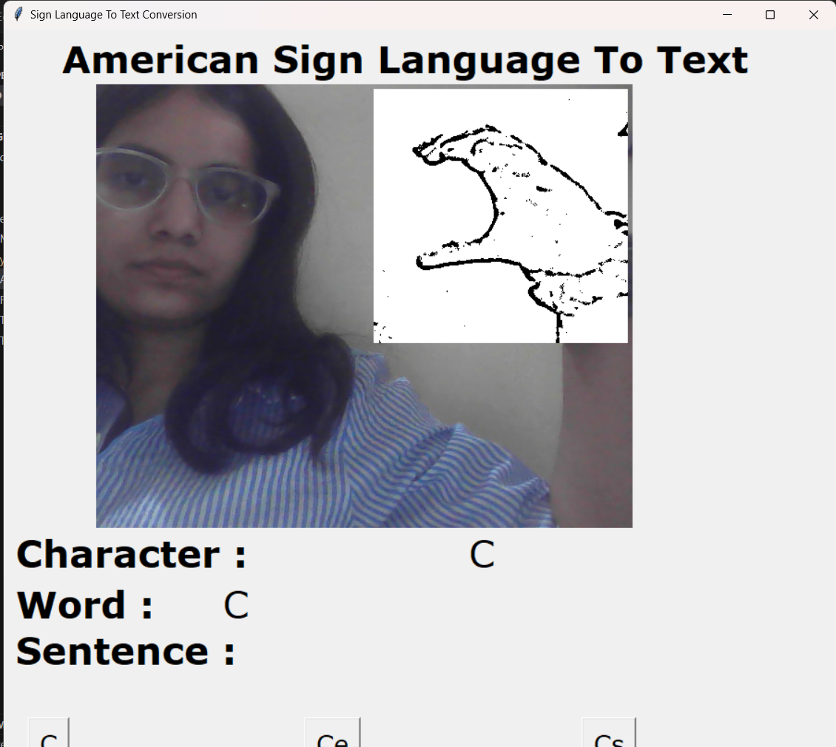
Results

Slide 12
Conclusion
In conclusion, live ASL interpretation plays a vital role in breaking communication barriers and promoting inclusivity for the Deaf and Hard of Hearing communities. With the integration of skilled interpreters, advanced tools like OpenCV, TensorFlow/PyTorch, and YOLO-based gesture recognition, accessibility has significantly improved across various fields, including education, healthcare, business, and entertainment. As technology continues to evolve, the future of ASL interpretation will likely see even greater advancements, making real-time communication more seamless and widely available. Ensuring continued support and innovation in this field is essential for fostering a truly inclusive society.

Slide 13
Future Scope
This project aims to develop a real-time ASL-to-text conversion system using AI and computer vision to enhance communication for the Deaf and Hard-of-Hearing (DHH) community.
Key Features:
Real-time Gesture Recognition: Uses deep learning models to accurately interpret ASL signs.
Multi-angle & Context Awareness: Supports facial expressions and sentence structures for improved accuracy.
Cross-platform Integration: Compatible with mobile apps, web platforms, and smart devices.
IoT & Wearables: Potential for smart gloves or AR glasses for seamless interaction.
Speech Conversion: Converts recognized text into speech for accessibility.
Social Impact: Enhances education, workplace inclusivity, and public service accessibility.

Slide 14
References
Kim, J., & Park, S. (2022). Enhanced ASL Recognition Using Transformer-Based Models. This paper discusses the application of transformer networks for improving ASL gesture recognition accuracy and text translation.
Zhou, Y., & Zhang, L. (2022). Multimodal ASL Recognition with Attention Mechanisms. The study explores using attention mechanisms across multiple modalities (e.g., gestures, facial expressions) to improve ASL to text conversion.
Nguyen, T., & Pham, H. (2022). Real-Time ASL to Text Conversion Using Lightweight Neural Networks. This research focuses on developing lightweight neural networks optimized for mobile and embedded devices to perform real-time ASL recognition and text conversion.
Smith, A., & Johnson, R. (2023). Hybrid CNN-RNN Models for Improved ASL Alphabet Recognition. The paper discusses combining Convolutional Neural Networks (CNN) with Recurrent Neural Networks (RNN) for more accurate recognition of ASL alphabets and conversion to text.
Wang, X., & Li, Y. (2023). Advancements in ASL Gesture Recognition with Self-Supervised Learning. This research introduces self-supervised learning techniques to enhance the performance of ASL gesture recognition systems.
Patel, D., & Shah, P. (2023). ASL to Text Translation Using Generative Pre-trained Transformer Models. This study explores the use of generative pre-trained transformers (GPT) to convert ASL gestures into meaningful text sentences.
Garcia, M., & Hernandez, L. (2023). Low-Latency ASL Recognition Systems with Edge Computing. The paper discusses implementing ASL to text conversion using edge computing to achieve low latency and real-time processing.
Chen, H., & Lin, J. (2024). Context-Aware ASL Recognition Using Deep Learning and NLP Techniques. This research integrates deep learning with natural language processing (NLP) to consider the context in which ASL gestures are made, improving the accuracy of text conversion.
Sato, K., & Nakamura, Y. (2024). Robust ASL Recognition in Challenging Environments Using Enhanced Image Processing Techniques. The study focuses on improving ASL recognition in low-light and noisy environments using advanced image processing algorithms.
Williams, E., & Thompson, B. (2024). Real-Time ASL to Text Conversion for Wearable Devices. This paper presents a system for converting ASL gestures to text in real-time using wearable devices, focusing on optimizing models for low power consumption and high accuracy.
Lee, J., & Kim, H. (2024). Adaptive ASL Gesture Recognition System with Incremental Learning. This study introduces an adaptive system that improves ASL gesture recognition accuracy over time through incremental learning techniques.
Miller, C., & Allen, R. (2024). Enhanced ASL to Text Conversion with Hybrid Vision-Language Models. The paper explores hybrid models that combine visual and linguistic features to improve the conversion of ASL gestures into text.

